Slide 1
Gym Member Manager Internal Guide :Dr. K.Ram Mohan Rao
By
P. Sai Venunath 1602-16-737-038
K.Rohith 1602-17-737-030
Team-1

Slide 2
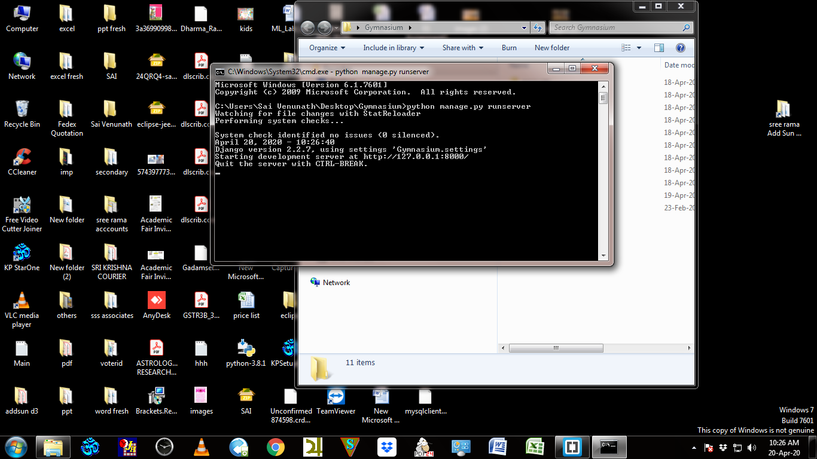

Slide 3
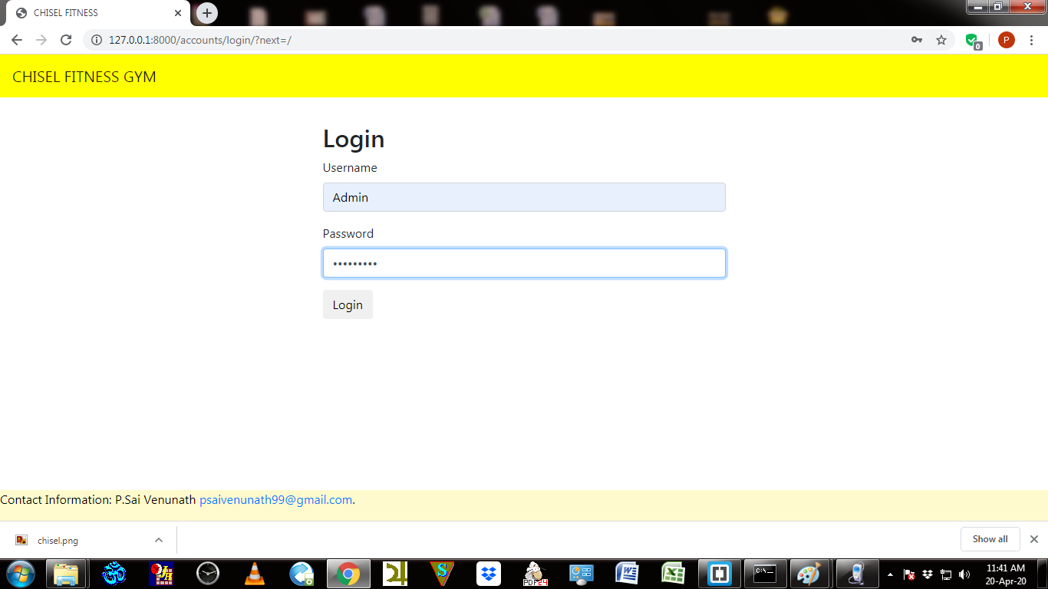

Slide 4
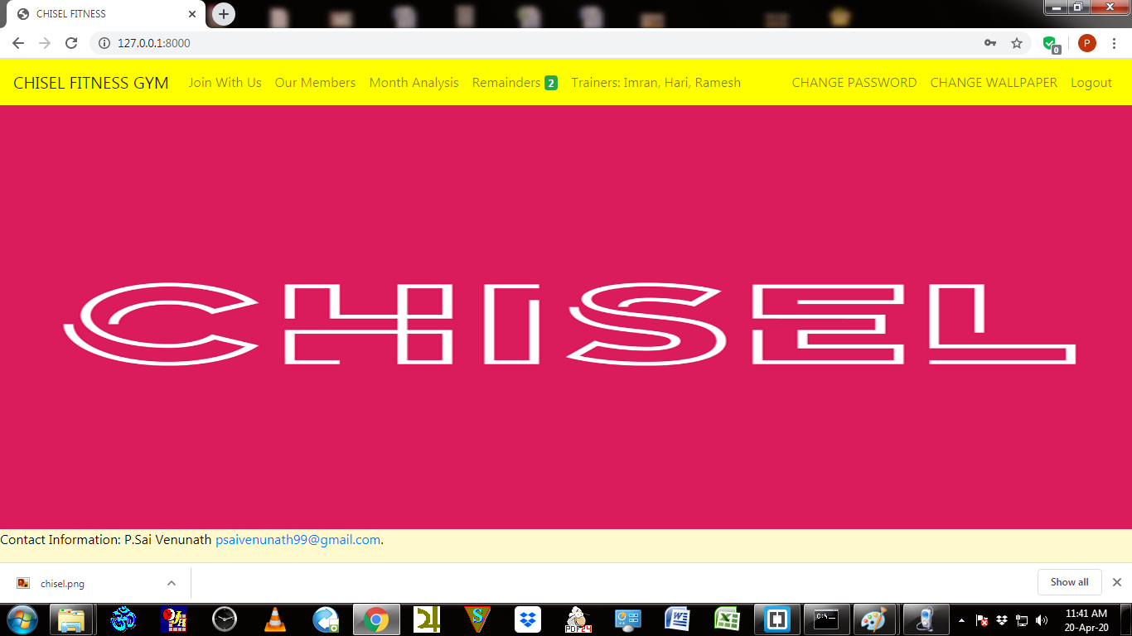

Slide 5
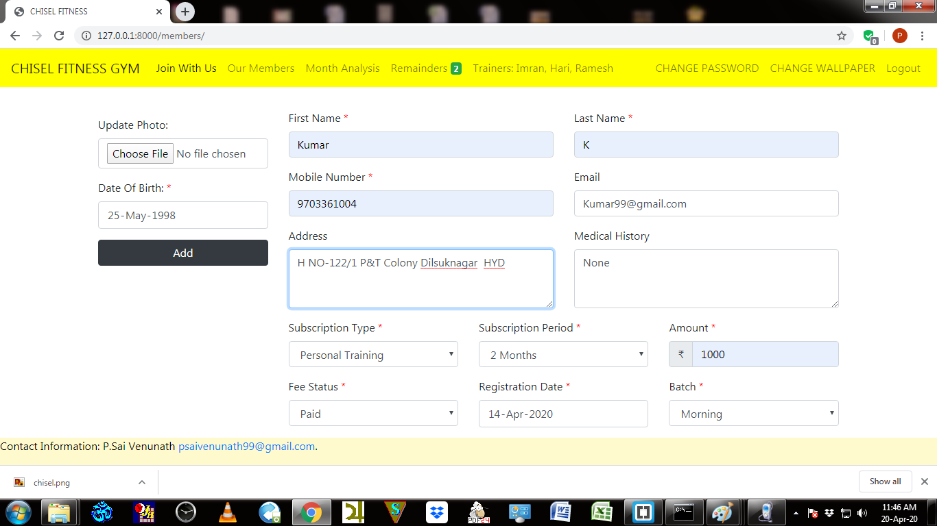

Slide 6
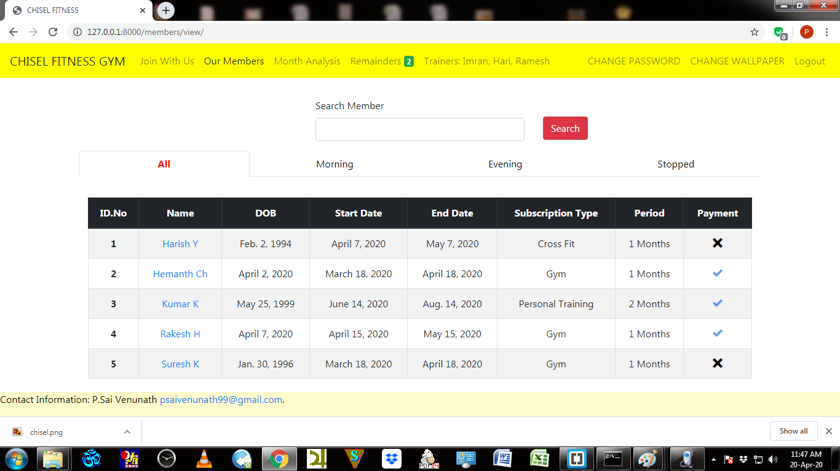

Slide 7
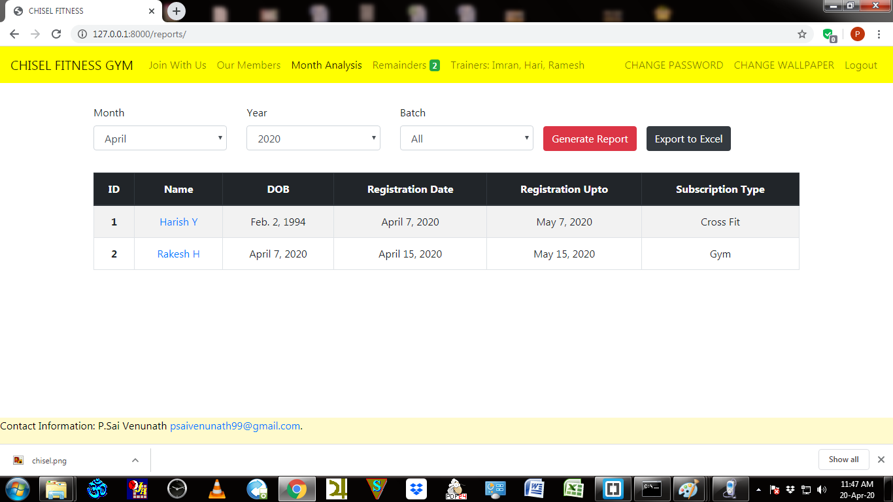

Slide 8
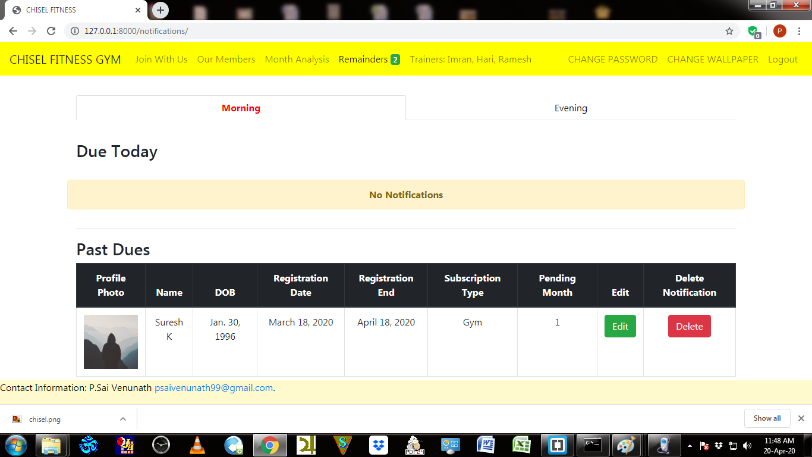

Slide 9
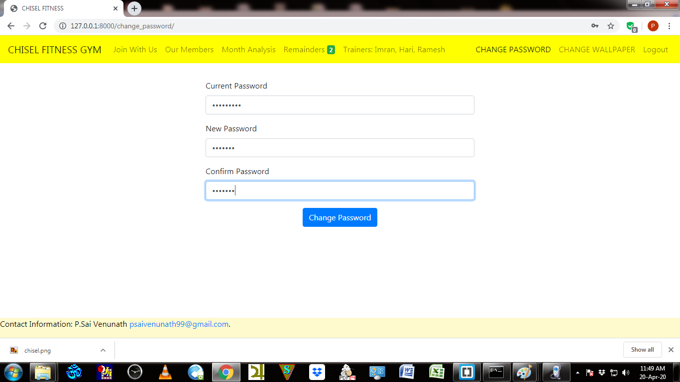

Slide 10
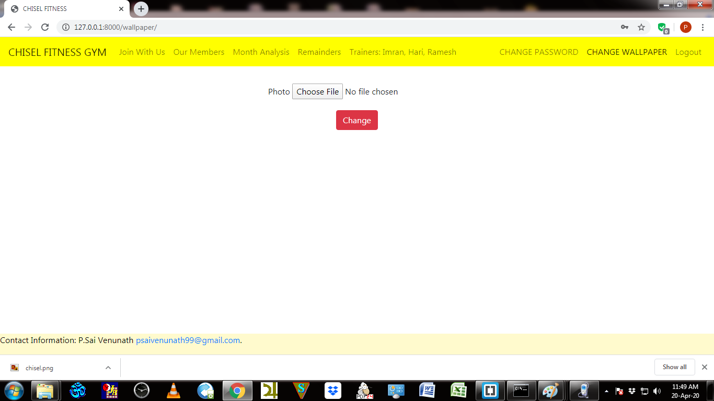

Slide 11
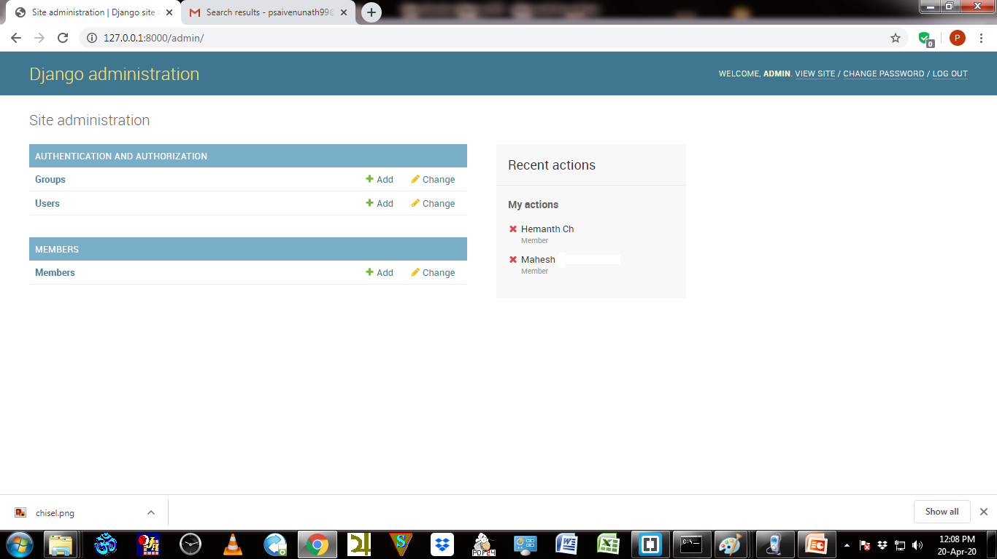

Slide 12
Future Scope
→ Notifications Of Fee Payment can be send to the customers mobile number a day before the deadline.
→Health care Chatbot can be introduced in the website so that customers can clarify their issues on fitness.

Slide 13
References
https://www.udemy.com/course/projects-in-django-learn-django-building-projects/
https://docs.djangoproject.com/en/3.0/ref/contrib/admin/
https://getbootstrap.com/docs/4.0/components/navbar/
https://www.w3schools.com/js/

